Slide 1
Innovation for AAL

Slide 2



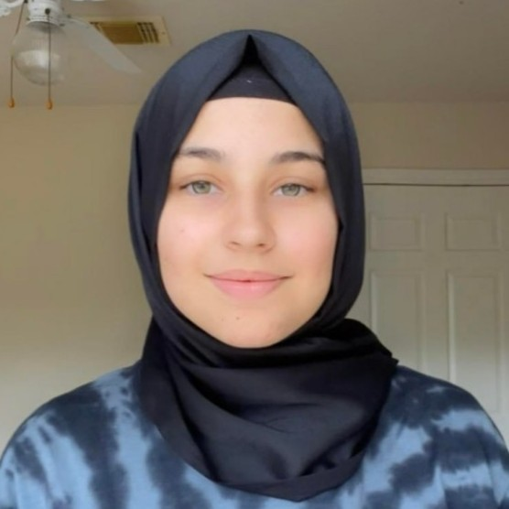
Meet our Team
Luis Alarcon CSCE 22’
Santana Gonzales
ITDE 23’
Juan Perez
ISEN 21’
Mualla Argin
CPSC 23’
Notes:
Hello, we are team #, and our names are: ….

Slide 3

Business Thesis
Our team will identify KPIs that the Army Applications Lab can use to evaluate the success of innovation projects
Notes:
Juan

Slide 4

Initial Roadmap
Analyze data provided by AAL
Sort AAL’s data and find metrics to evaluate innovation
Incorporate metrics into an user-friendly tool
Notes:
We thought AAL had a lot of data, and we just had to go over all of the data and sort it
Then we discovered they didn’t have a lot of data, and they data they had was not really useful for us (no metrics for ROI)

Slide 5

Key Interview -
Dr. Casey Perley
Expertise:
Director of Technical Insights & Analysis at AAL
Insights:
Provides real data from AAL
Give key feedback on AAL ‘wants’ in the product
Constraints on metrics and concerns for bias in data

Slide 6

Key Interviews - Chris Curran
Expertise:
Former CTO of PwC
TAMU Entrepreneurship Professor
Insights:
Push to get more general info about AAL
Breaking metrics into categories
Consolidating product to a MVP

Slide 7

Key Interviews - Chad Lewis
Expertise:
President and Cofounder of Peak Nano
Insights:
Defining clear expectations for projects
Measuring project success via milestones

Slide 8
Number of Customer Interviews
So far we have 10 customer interviews
Most Recently:
Dr. Casey Perley, Chris Curran, Chad Lewis
Planned Interviews:
Jim Rabuck, Blake Petty , Trip to AAL
Notes:
Add number of customer interviews

Slide 9
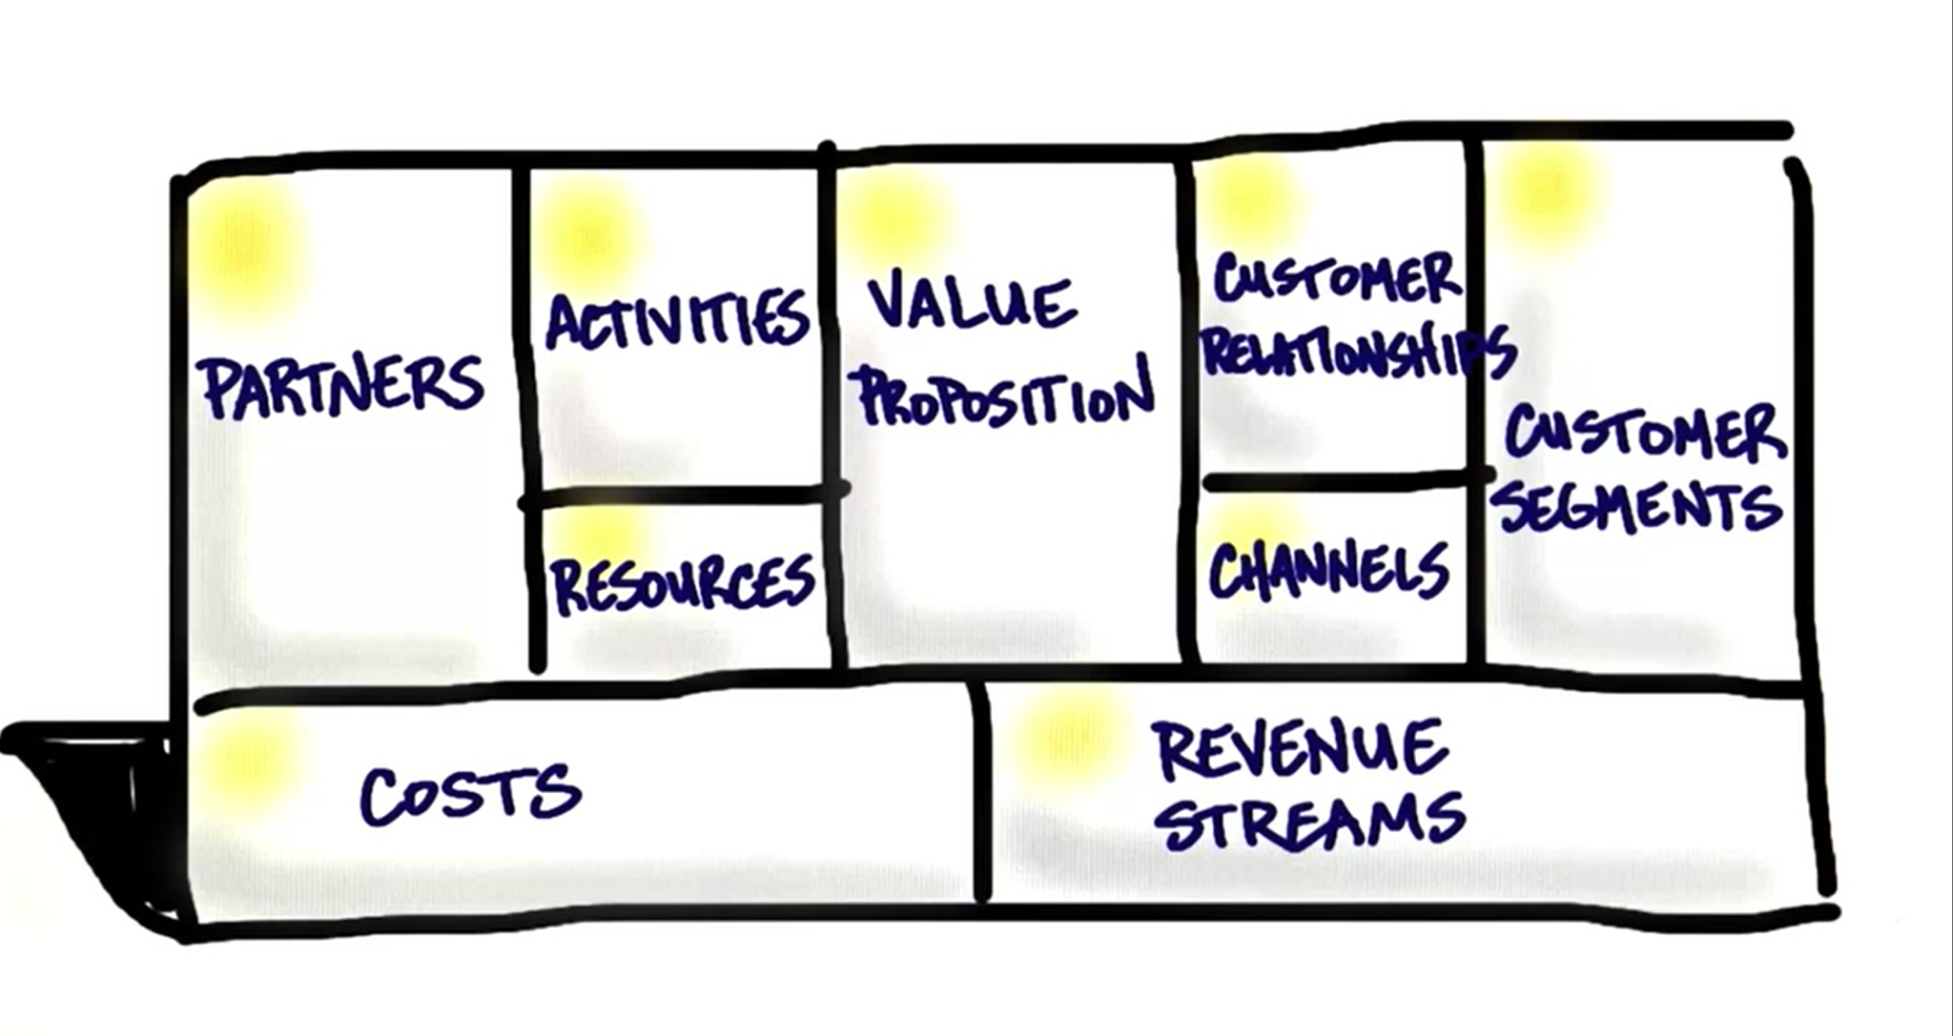
Mission Model Canvas

Slide 10

Value Proposition
We return the power of choice to our customers by measuring the innovative success of their investment mid project.

Slide 11

Customer Segments
Primary Example
Army Application Laboratory
Type
Business to Business
Description
Business that are invested in research and development projects that are interested in measuring the innovative success through KPIs

Slide 12
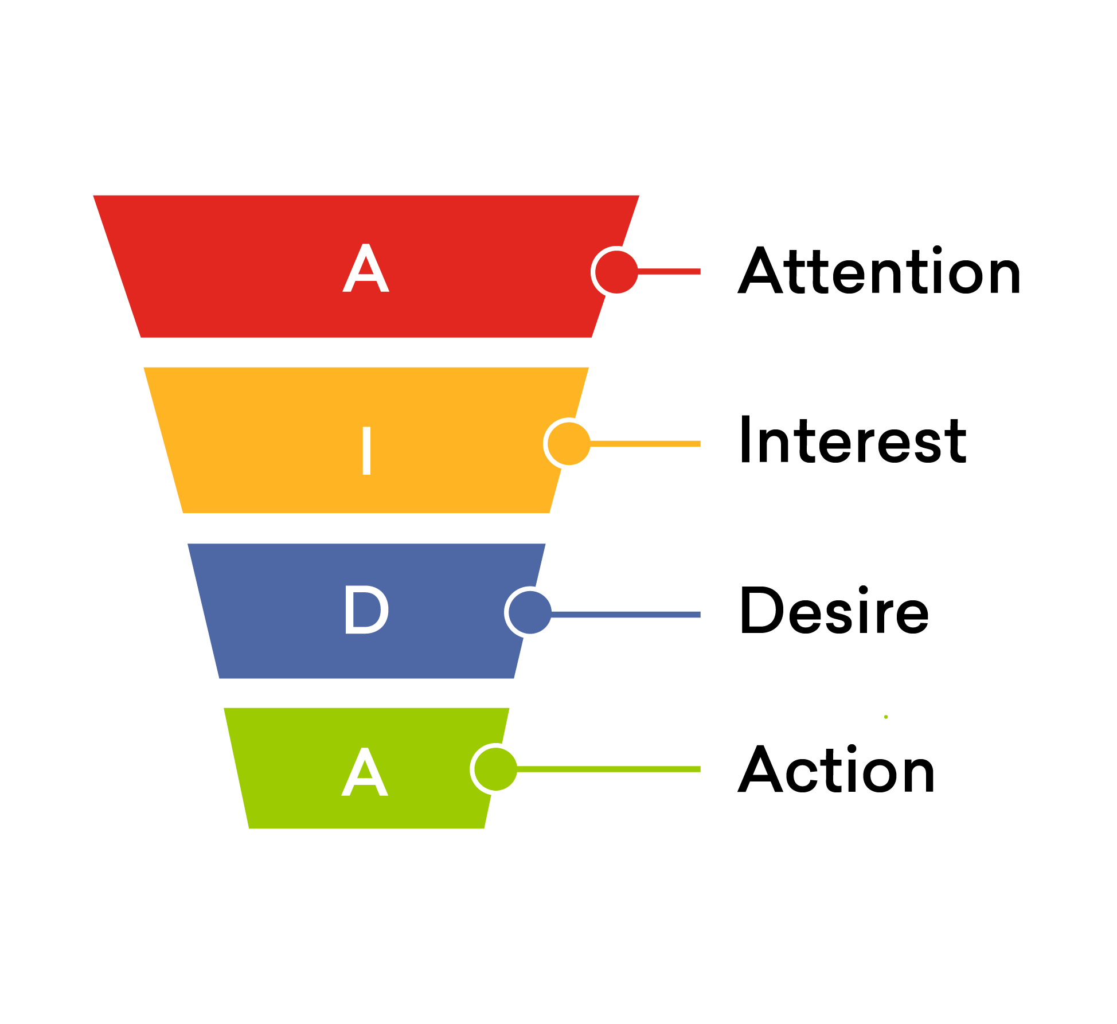
Channels
Physical Channels
Word of mouth
Tech Conferences
Online Channels
Email
Website

Slide 13

Revenue Streams
Subscription Based
Monthly
Yearly
Prices based on size of business
More data will require more service
Value
The ability to catch a project to fail is saving millions of dollars

Slide 14

Key Partners
Army Applications Laboratory
U.S. Army Combined Arms Support Command
Long Range Precision Fires Cross Functional Team
Next Generation Combat Vehicles Cross Functional Team
and more..
Notes:
Key Partners
Who are the key partners and the suppliers needed to make the business model work?
What key resources are we acquiring from them?
What key activities do they perform
CASCOM - U.S. Army combined arms support command (trains army &civilians)
LRPF - Long Range Precision Fires
NETWORK - Ask Perley
NGCV - Next Generation Combat Vehicles
PNT - Positioning, Navigation and Timing. ... Navigation is the ability to determine current and desired position and apply corrections to course, orientation, and speed to attain a desired position anywhere around the world, from surface to surface and from surface to space.

Slide 15

Possible Solution
Determine a basket of KPIs that should be tracked by AAL
Create a document for tracking those metrics
Incorporate metrics to a tool/dashboard that’s easy to use

Slide 16
Next Steps:
Trip to Army Applications Laboratory
Evaluate companies based on previously determined KPIs
Dashboard integrated with more features
Notes:
Austin trip
Pushing a bit more on ranking companies
Dashboard integrated with more helpful features

Slide 17
Questions?

Slide 18
References:
https://aal.army/
https://aal.army/what-we-do/
https://aal.army/our-team/
https://www.mckinsey.com/business-functions/strategy-and-corporate-finance/our-insights/how-to-take-the-measure-of-innovation

